Slide 1


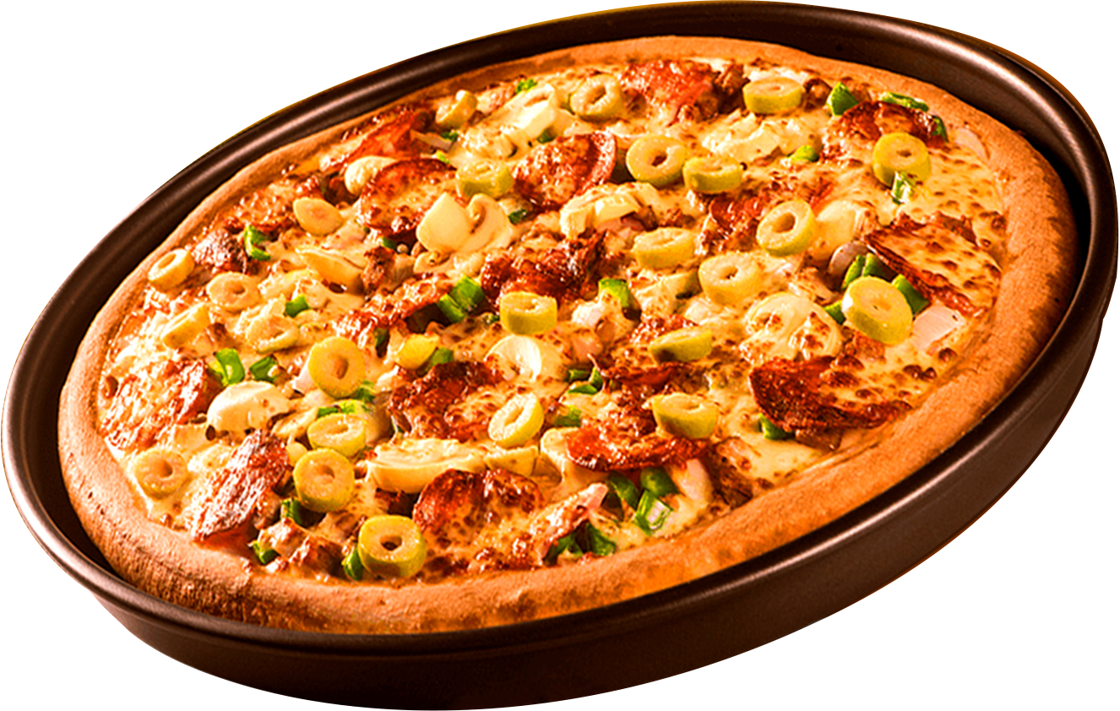
PIZZA SALES
MYSQL PROJECT
Start Your Slide

Slide 2

ABOUT DATASATES
Datasets contains 4 table of pizza sale over one year
1. Pizza
2. Pizza Types
3. Orders
4. Order Details

Slide 3
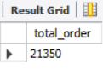
RETRIEVE THE TOTAL NUMBER OF ORDERS PLACED.

Slide 4
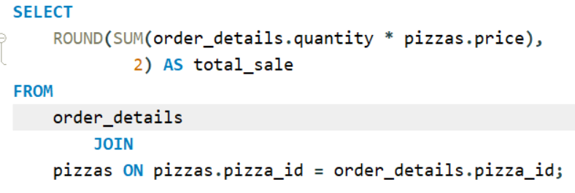
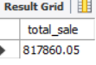
CALCULATE THE TOTAL REVENUE GENERATED FROM PIZZA SALES.

Slide 5
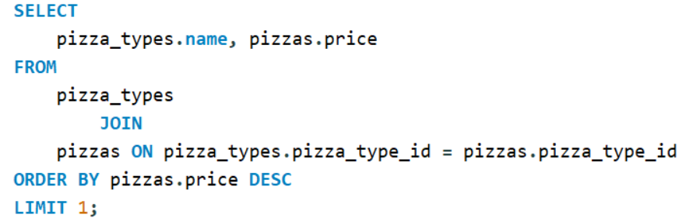
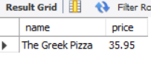
IDENTIFY THE HIGHEST-PRICED PIZZA.

Slide 6
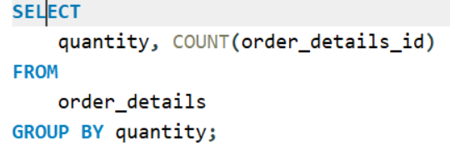
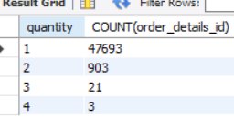
IDENTIFY THE MOST COMMON QUANTITY OF PIZZA ORDERED.

Slide 7
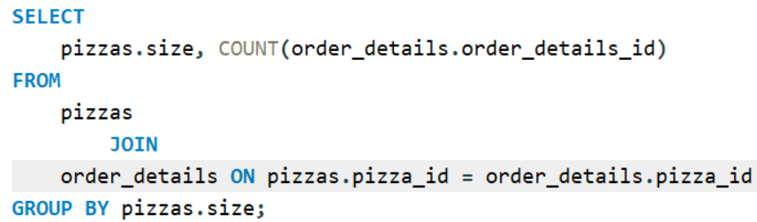
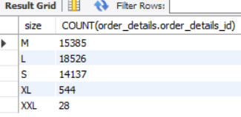
IDENTIFY THE MOST COMMON PIZZA SIZE ORDERED.

Slide 8
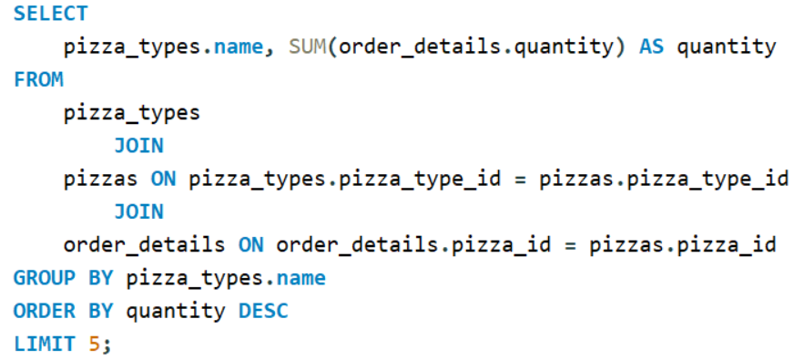
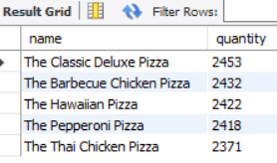
LIST THE TOP 5 MOST ORDERED PIZZA TYPES ALONG WITH THEIR QUANTITIES.

Slide 9
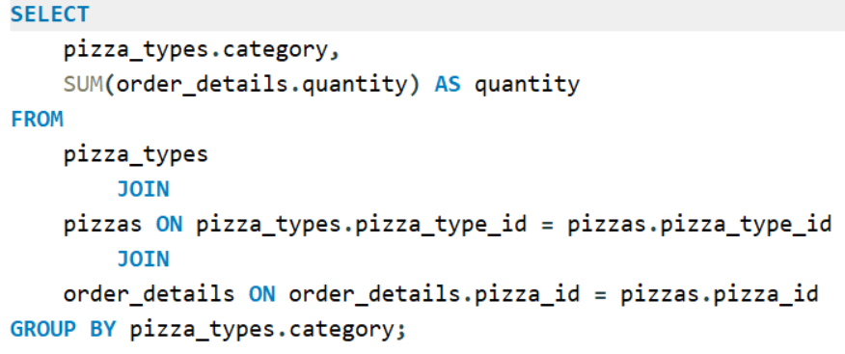
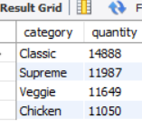
JOIN THE NECESSARY TABLES TO FIND THE TOTAL QUANTITY OF EACH PIZZA CATEGORY ORDERED.

Slide 10
JOIN THE NECESSARY TABLES TO FIND THE TOTAL QUANTITY OF EACH PIZZA CATEGORY ORDERED.

Slide 11
JOIN THE NECESSARY TABLES TO FIND THE TOTAL QUANTITY OF EACH PIZZA CATEGORY ORDERED.

Slide 12
JOIN THE NECESSARY TABLES TO FIND THE TOTAL QUANTITY OF EACH PIZZA CATEGORY ORDERED.

Slide 13
JOIN THE NECESSARY TABLES TO FIND THE TOTAL QUANTITY OF EACH PIZZA CATEGORY ORDERED.

Slide 14
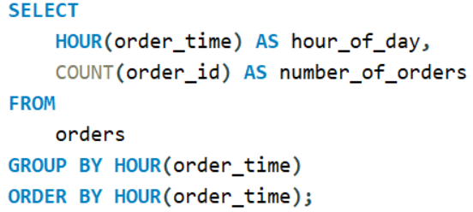
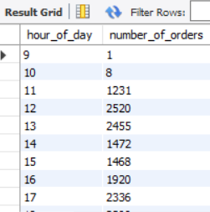
DETERMINE THE DISTRIBUTION OF ORDERS BY HOUR OF THE DAY.

Slide 15
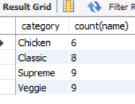
JOIN RELEVANT TABLES TO FIND THE CATEGORY-WISE DISTRIBUTION OF PIZZAS.

Slide 16
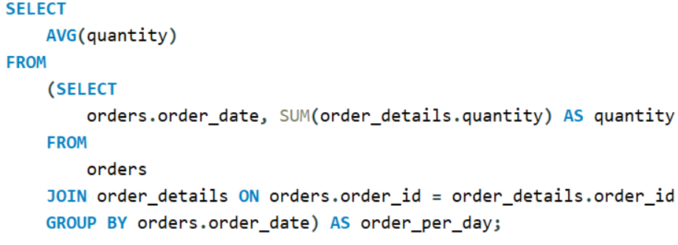
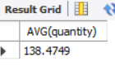
GROUP THE ORDERS BY DATE AND CALCULATE THE AVERAGE NUMBER OF PIZZAS ORDERED PER DAY.

Slide 17
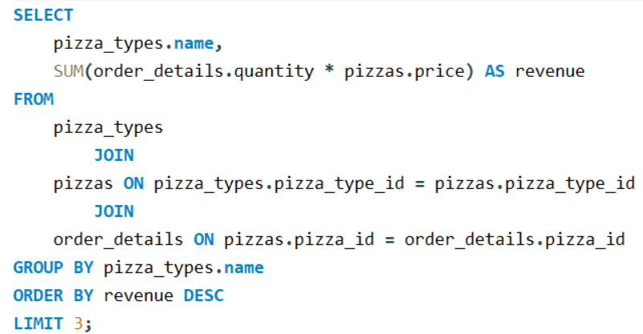
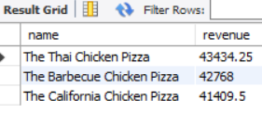
DETERMINE THE TOP 3 MOST ORDERED PIZZA TYPES BASED ON REVENUE.

Slide 18
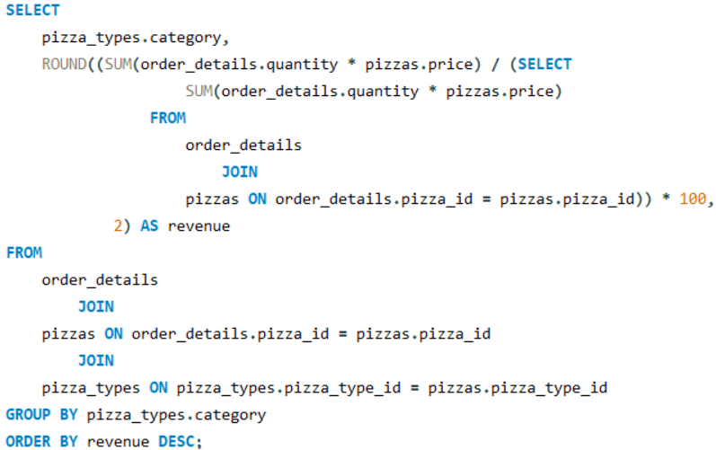
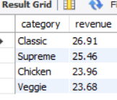
CALCULATE THE PERCENTAGE CONTRIBUTION OF EACH PIZZA TYPE TO TOTAL REVENUE.

Slide 19
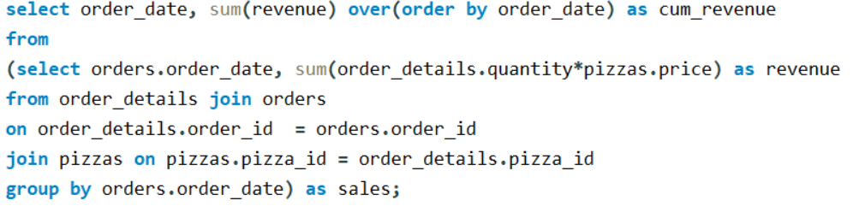
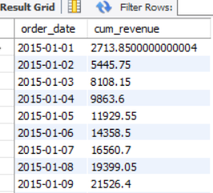
ANALYZE THE CUMULATIVE REVENUE GENERATED OVER TIME.

Slide 20
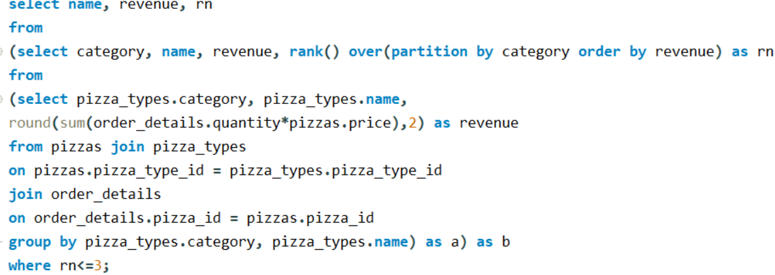
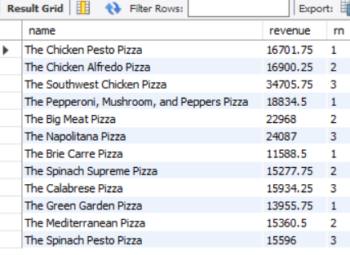
DETERMINE THE TOP 3 MOST ORDERED PIZZA TYPES BASED ON REVENUE FOR EACH PIZZA CATEGORY.

Slide 21
THANK YOU!
Vinod Kumariya...

